Slide 1
Use SolidWorks Simulation to determine
The force in each member of the truss.
The reactions at A and B.
Use any pipe Structural Member, Alloy Steel as the material, and answer the question: Does the cross-section change the force in the members?
8 m
20 kN
3 m
15 kN
6 m
30 kN

Slide 2
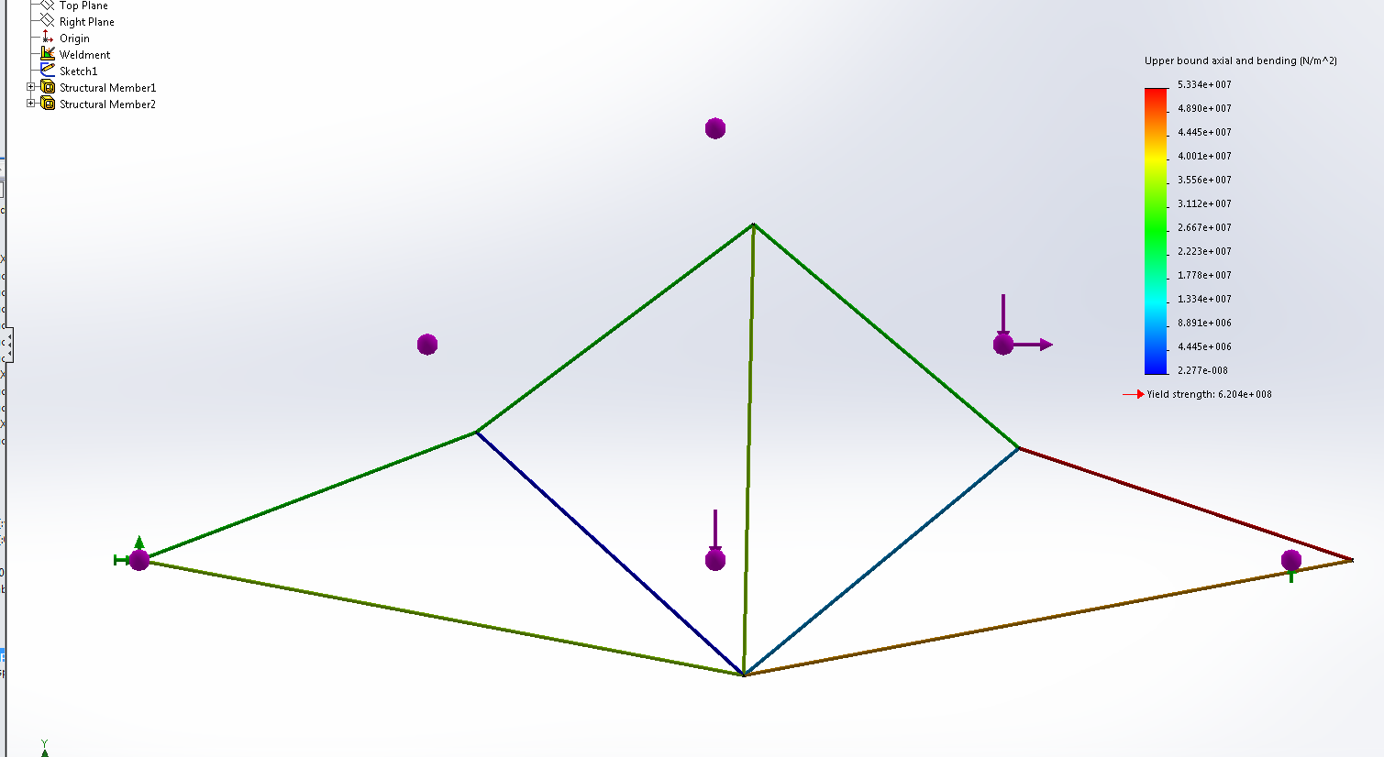
SOLUTION: Setting up the problem in SolidWorks Simulation and running the FEA Solver generates the following result.

Slide 3
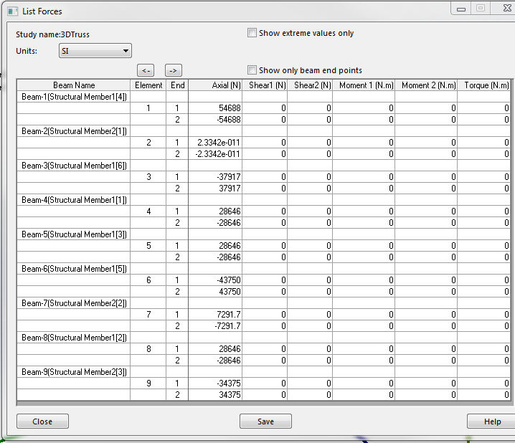
Under the Simulation Feature Manager, with the Right-Mouse-Button select “Results” and then select “List Beam Forces” to generate a table of loads on each element of the truss.

Slide 4
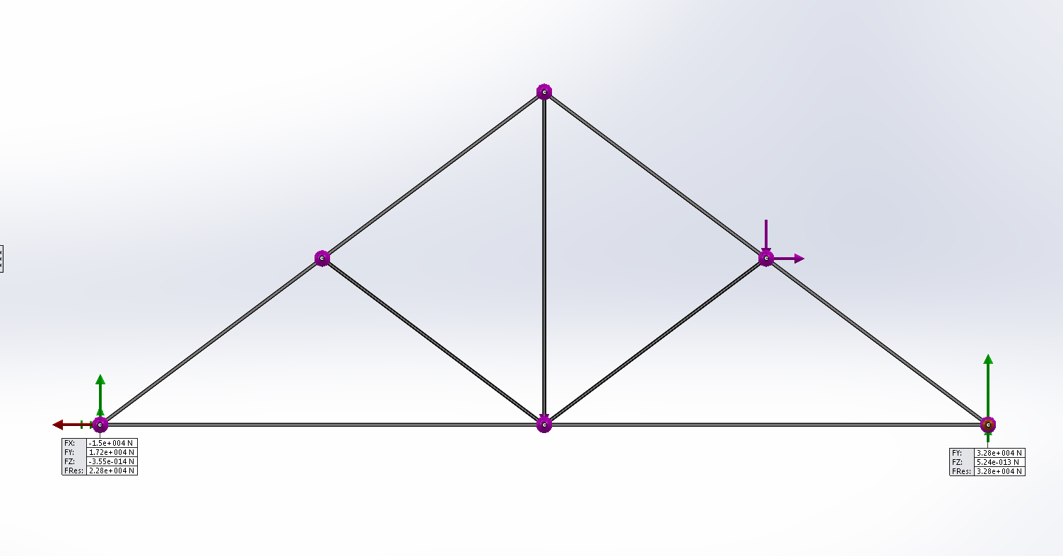
Under the Simulation Feature Manager, with the Right-Mouse-Button select “Results” and then select “List Resultant Forces” to show the reactions where the constraints are applied.

Slide 5
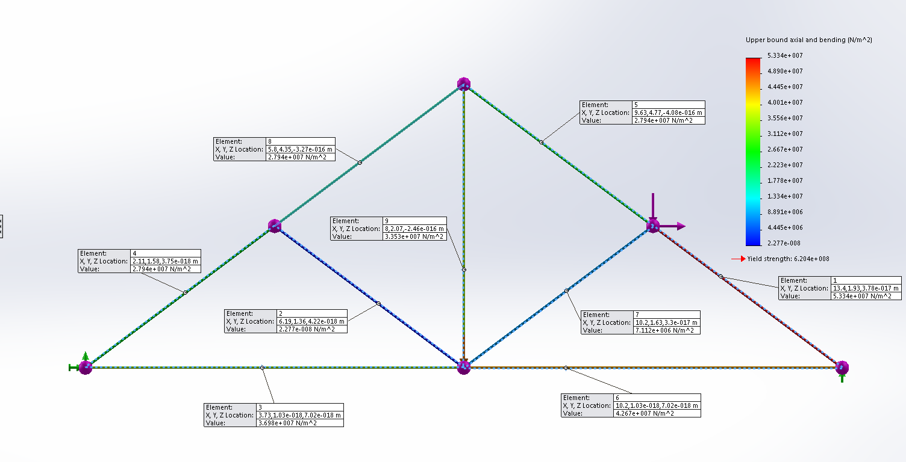
Under the Simulation Feature Manager “Results” tree, with the Right-Mouse-Button select “Probe” and then select members on the truss to show the stress in the member.
The stress in a member is a function of the cross-section; however, the force in each member is independent of cross-section.

